Slide 1
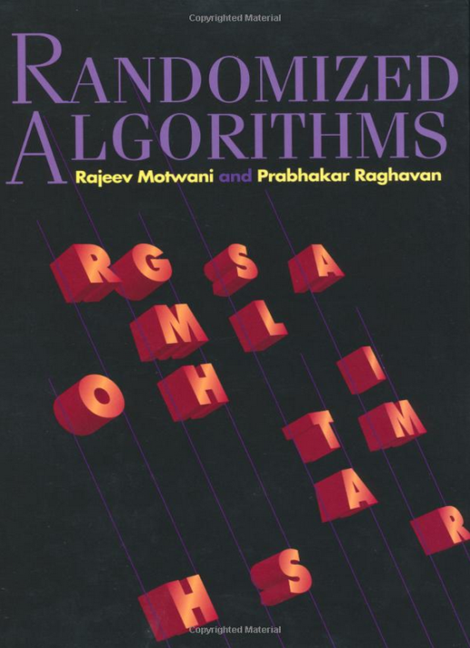
Random Treaps
Prepared by Shmuel Wimer
Courtesy of Prof. Dror Rawitz

Slide 2



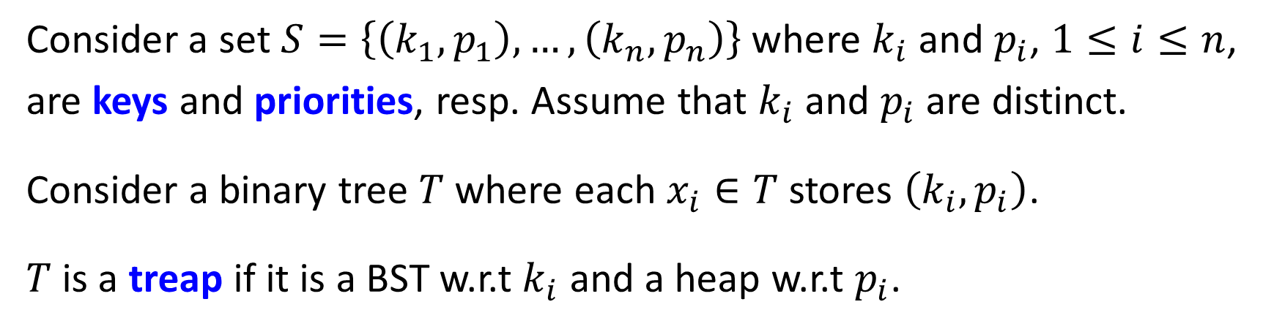




Consider a set $S=\left\{\left(k_{1},p_{1}\right), …,\left(k_{n},p_{n}\right)\right\}$ where $k_{i}$ and $p_{i}$, $1≤i≤n$, are keys and priorities, resp. Assume that $k_{i}$ and $p_{i}$ are distinct.
Consider a binary tree $T$ where each $x_{i}∈T$ stores $\left(k_{i},p_{i}\right)$.
$T$is a treap if it is a BST w.r.t $k_{i}$ and a heap w.r.t $p_{i}$.
$$S=\left\{\left(2,13\right),\left(4,26\right),\left(6,19\right),\left(7,30\right),\left(9,14\right),\left(11,27\right),\left(12,22\right)\right\}$$
$$7,30$$
$$4,26$$
$$11,27$$
$$2,13$$
$$6,19$$
1$2,22$
$$9,14$$

Slide 3
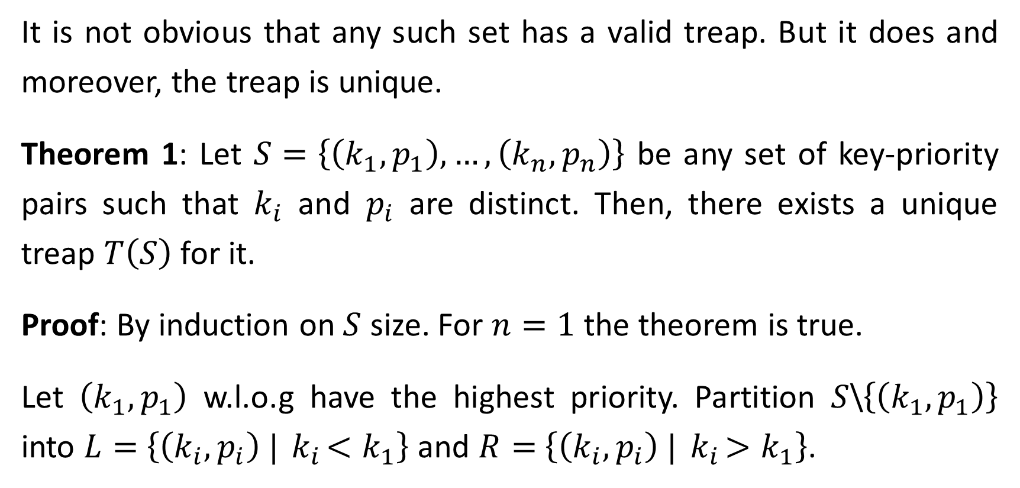
It is not obvious that any such set has a valid treap. But it does and moreover, the treap is unique.
Theorem 1: Let $S=\left\{\left(k_{1},p_{1}\right), …,\left(k_{n},p_{n}\right)\right\}$ be any set of key-priority pairs such that $k_{i}$ and $p_{i}$ are distinct. Then, there exists a unique treap $T\left(S\right)$ for it.
Proof: By induction on $S$ size. For $n=1$ the theorem is true.
Let $\left(k_{1},p_{1}\right)$ w.l.o.g have the highest priority. Partition $S$\$\left\{\left(k_{1},p_{1}\right)\right\}$ into $L=$ $\left\{\left(k_{i},p_{i}\right) |{ k}_{i}<k_{1}\right\}$ and $R=$ $\left\{\left(k_{i},p_{i}\right) |{ k}_{i}>k_{1}\right\}$.

Slide 4

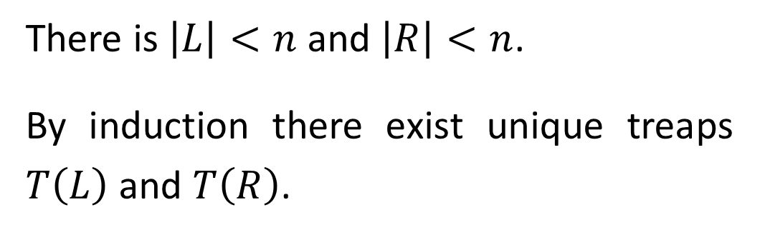
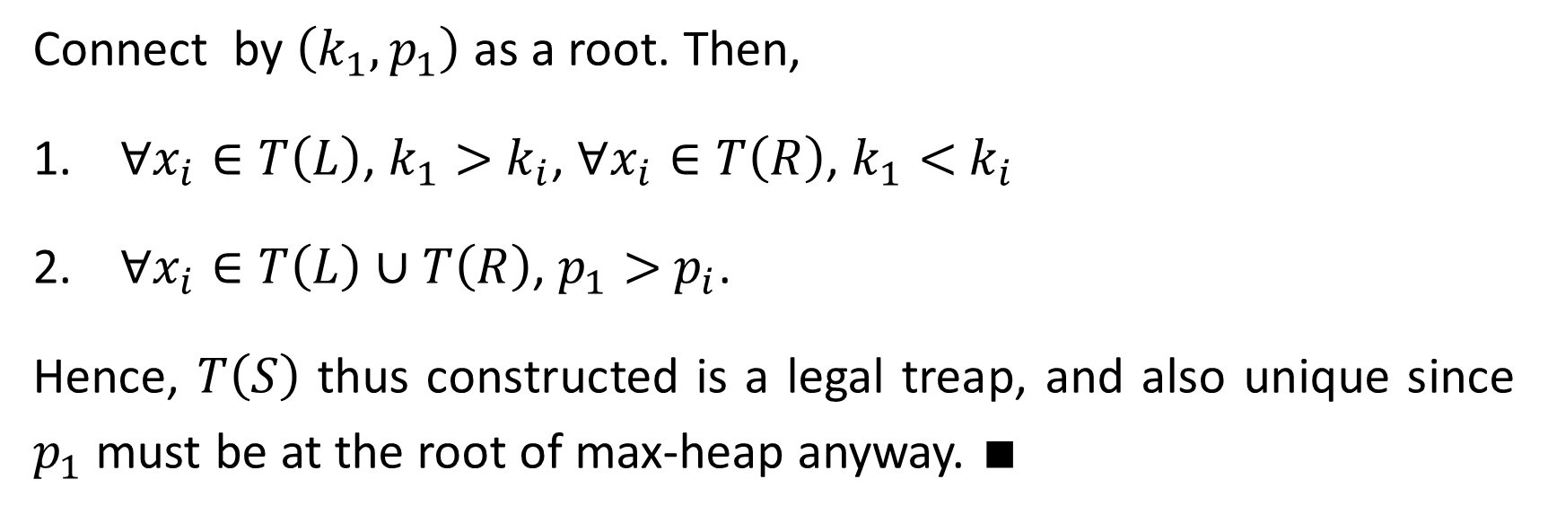


There is $\left|L\right|<n$ and $\left|R\right|<n$.
By induction there exist unique treaps $T\left(L\right)$ and $T\left(R\right)$.
$$\left(k_{1},p_{1}\right)$$
$$T\left(L\right)$$
$$T\left(R\right)$$
Connect by $\left(k_{1},p_{1}\right)$ as a root. Then,
$∀x_{i}∈T\left(L\right)$, $k_{1}>{ k}_{i}$, $∀x_{i}∈T\left(R\right)$, $k_{1}<{ k}_{i}$
$∀x_{i}∈T\left(L\right)∪T\left(R\right)$, $p_{1}>{ p}_{i}$.
Hence, $T\left(S\right)$ thus constructed is a legal treap, and also unique since $p_{1}$ must be at the root of max-heap anyway. $∎$

Slide 5
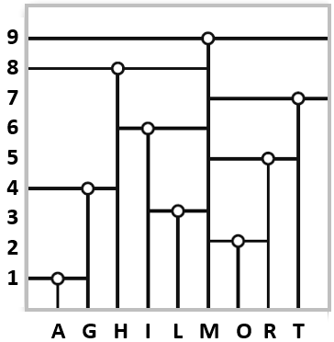



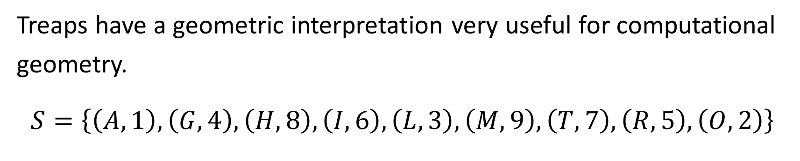






Treaps have a geometric interpretation very useful for computational geometry.
$$S=\left\{\left(A,1\right),\left(G,4\right),\left(H,8\right),\left(I,6\right),\left(L,3\right),\left(M,9\right),\left(T,7\right),\left(R,5\right),\left(O,2\right)\right\}$$
$$M,9$$
$$H,8$$
$$U,7$$
$$G,4$$
$$I,6$$
$$R,5$$
$$A,1$$
$$L,3$$
$$O,2$$

Slide 6
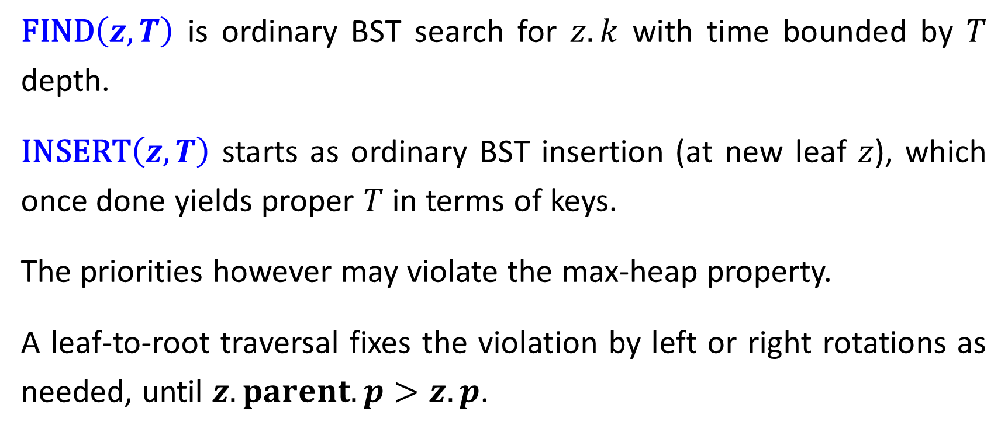
Treap Operations
$\text{FIND}\left(z,T\right)$ is ordinary BST search for $z.k$ with time bounded by $T$ depth.
$\text{INSERT}\left(z,T\right)$ starts as ordinary BST insertion (at new leaf $z$), which once done yields proper $T$ in terms of keys.
The priorities however may violate the max-heap property.
A leaf-to-root traversal fixes the violation by left or right rotations as needed, until $z.parent.p>z. p$.

Slide 7





















$$\text{INSERT}\left(\left(U,10\right),T\right)$$
$$M,9$$
$$M,9$$
$$H,8$$
$$V,7$$
right rotation
$$H,8$$
$$V,7$$
$$G,4$$
$$I,6$$
$$U,10$$
$$G,4$$
$$I,6$$
$$R,5$$
$$A,1$$
$$L,3$$
$$R,5$$
$$A,1$$
$$L,3$$
$$O,2$$
$$U,10$$
$$O,2$$
left rotation

Slide 8




















$$U,10$$
$$M,9$$
$$M,9$$
$$V,7$$
$$H,8$$
$$U,10$$
left rotation
$$H,8$$
$$R,5$$
$$G,4$$
$$I,6$$
$$R,5$$
$$V,7$$
$$G,4$$
$$I,6$$
$$O,2$$
$$A,1$$
$$L,3$$
$$O,2$$
$$A,1$$
$$L,3$$

Slide 9
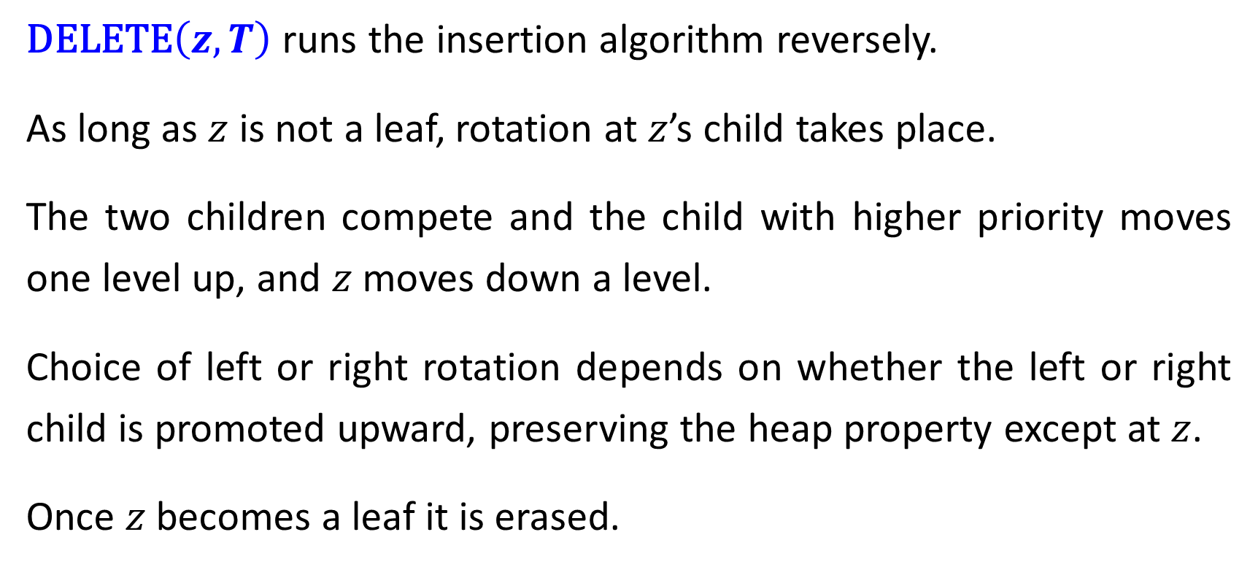
$\text{DELETE}\left(z,T\right)$ runs the insertion algorithm reversely.
As long as $z$ is not a leaf, rotation at $z$’s child takes place.
The two children compete and the child with higher priority moves one level up, and $z$ moves down a level.
Choice of left or right rotation depends on whether the left or right child is promoted upward, preserving the heap property except at $z$.
Once $z$ becomes a leaf it is erased.

Slide 10













$$\text{DELETE}\left(\left(M,9\right),T\right)$$
$$U,10$$
$$U,10$$
right rotation
$$M,9$$
$$V,7$$
$$H,8$$
$$V,7$$
right
rotation
$$H,8$$
$$R,5$$
$$G,4$$
$$M,9$$
$$G,4$$
$$I,6$$
$$O,2$$
$$A,1$$
$$I,6$$
$$R,5$$
$$A,1$$
$$L,3$$
$$L,3$$
$$O,2$$

Slide 11













$$U,10$$
$$U,10$$
$$H,8$$
$$V,7$$
$$H,8$$
$$V,7$$
$$G,4$$
$$I,6$$
$$G,4$$
$$I,6$$
$$A,1$$
$$M,9$$
$$A,1$$
$$R,5$$
left rotation
$$L,3$$
$$R,5$$
$$M,9$$
right rotation
$$O,2$$
$$L,3$$
$$O,2$$

Slide 12














$$U,10$$
$$U,10$$
$$H,8$$
$$V,7$$
$$H,8$$
$$V,7$$
$$G,4$$
$$I,6$$
$$G,4$$
$$I,6$$
$$A,1$$
$$R,5$$
$$A,1$$
$$R,5$$
$$L,3$$
$$L,3$$
$$M,9$$
$$O,2$$
left rotation
$$O,2$$
$$M,9$$

Slide 13
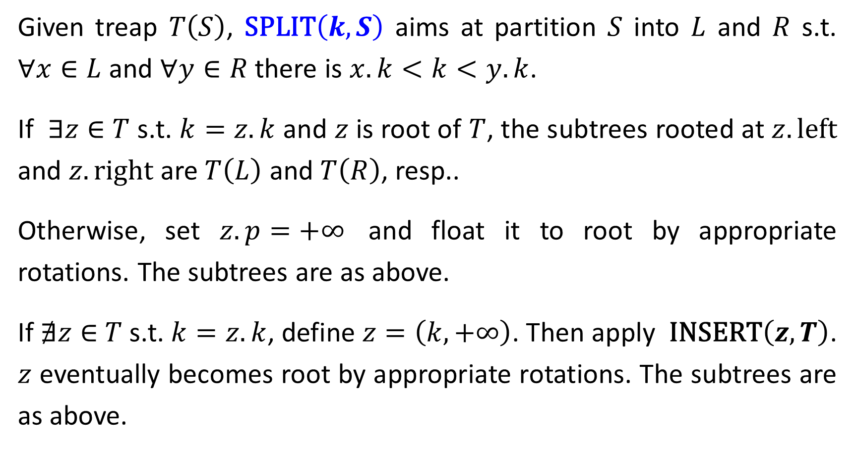
Given treap $T\left(S\right)$, $\text{SPLIT}\left(k,S\right)$ aims at partition $S$ into $L$ and $R$ s.t. $∀x∈L$ and $∀y∈R$ there is $x.k<k<y.k$.
If $∃z∈$ $T$ s.t. $k=z.k$ and $z$ is root of $T$, the subtrees rooted at $z.left$ and $z.right$ are $T\left(L\right)$ and $T\left(R\right)$, resp..
Otherwise, set $z.p=+∞$ and float it to root by appropriate rotations. The subtrees are as above.
If $∄z∈$ $T$ s.t. $k=z.k$, define $z=\left(k,+∞\right)$. Then apply $\text{INSERT}\left(z,T\right)$. $z$ eventually becomes root by appropriate rotations. The subtrees are as above.

Slide 14
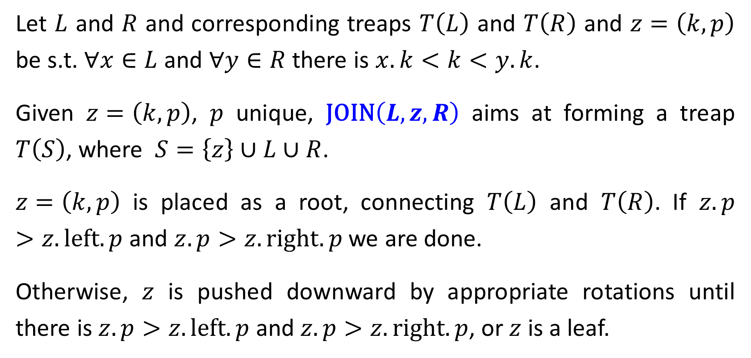
Let $L$ and $R$ and corresponding treaps $T\left(L\right)$ and $T\left(R\right)$ and $z=\left(k,p\right)$ be s.t. $∀x∈L$ and $∀y∈R$ there is $x.k<k<y.k$.
Given $z=\left(k,p\right)$, $p$ unique, $\text{JOIN}\left(L,z,R\right)$ aims at forming a treap $T\left(S\right)$, where $S=\left\{z\right\}∪L∪R$.
$z=\left(k,p\right)$ is placed as a root, connecting $T\left(L\right)$ and $T\left(R\right)$. If $z.p>z.\text{left}.p$ and $z.p>z.\text{right}.p$ we are done.
Otherwise, $z$ is pushed downward by appropriate rotations until there is $z.p>z.\text{left}.p$ and $z.p>z.\text{right}.p$, or $z$ is a leaf.

Slide 15
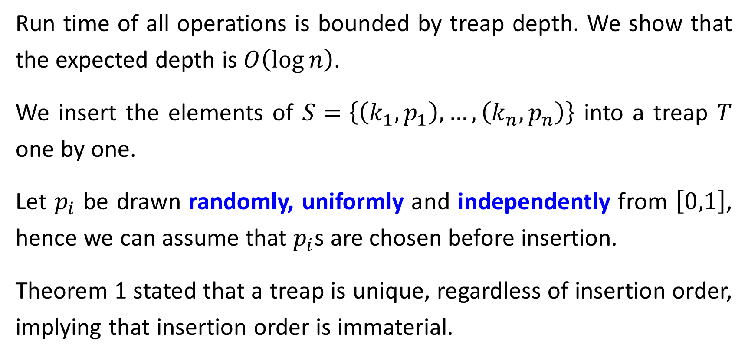
Run Time Analysis
Run time of all operations is bounded by treap depth. We show that the expected depth is $O\left(\log{n}\right)$.
We insert the elements of $S=\left\{\left(k_{1},p_{1}\right), …,\left(k_{n},p_{n}\right)\right\}$ into a treap $T$ one by one.
Let $p_{i}$ be drawn randomly, uniformly and independently from $\left[0,1\right]$, hence we can assume that $p_{i}$s are chosen before insertion.
Theorem 1 stated that a treap is unique, regardless of insertion order, implying that insertion order is immaterial.

Slide 16
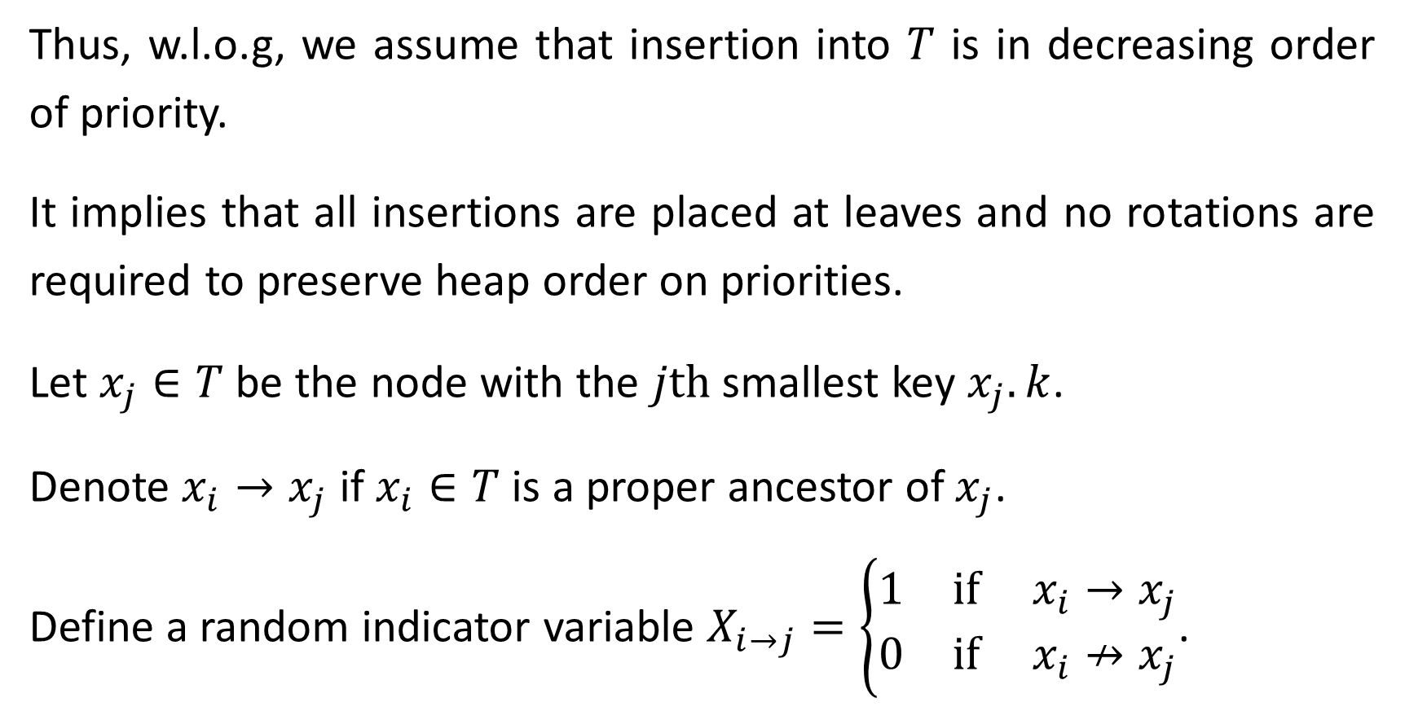
Thus, w.l.o.g, we assume that insertion into $T$ is in decreasing order of priority.
It implies that all insertions are placed at leaves and no rotations are required to preserve heap order on priorities.
Let $x_{j}∈T$ be the node with the $j\text{th}$ smallest key $x_{j}.k$.
Denote $x_{i}→x_{j}$ if $x_{i}∈T$ is a proper ancestor of $x_{j}$.
Define a random indicator variable $X_{i→j}=\left\{\begin{matrix}1 & \text{if} x_{i}→x_{j} \\ 0 & \text{if}{ x}_{i}↛x_{j}\end{matrix}\right.$.

Slide 17
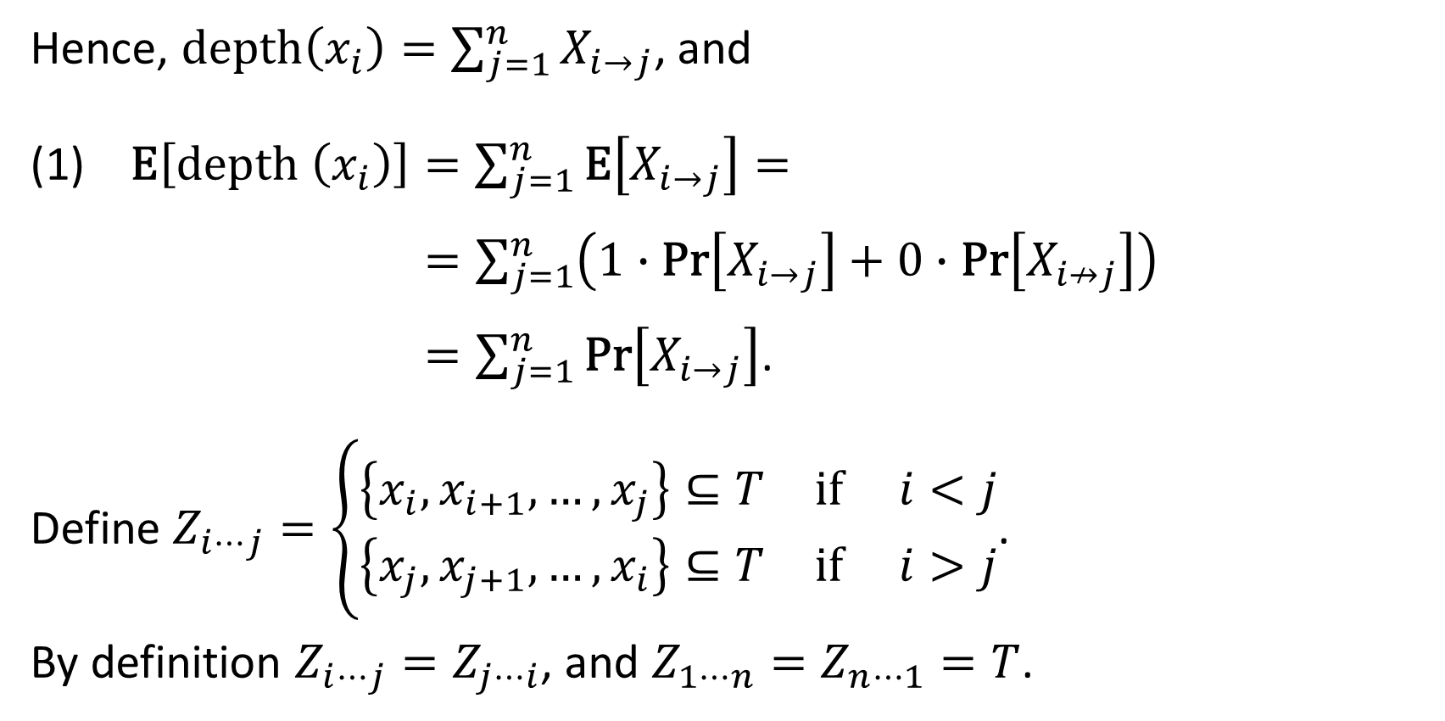
Hence, $\text{depth}\left(x_{i}\right)=\sum_{j=1}^{n}{X_{i→j}}$, and
(1) E$\left[\text{depth} \left(x_{i}\right)\right]=\sum_{j=1}^{n}{\text{E}\left[X_{i→j}\right]}=$
$=\sum_{j=1}^{n}{\left(1∙\text{Pr}\left[X_{i→j}\right]+0∙\text{Pr}\left[X_{i↛j}\right]\right)}$
$=\sum_{j=1}^{n}{\text{Pr}\left[X_{i→j}\right]}$.
Define $Z_{i⋯j}=\left\{\begin{matrix}\left\{x_{i},x_{i+1},…,x_{j}\right\}⊆T & \text{if} i<j \\ \left\{x_{j},x_{j+1},…,x_{i}\right\}⊆T & \text{if} i>j\end{matrix}\right.$.
By definition $Z_{i⋯j}=Z_{j⋯i}$, and $Z_{1⋯n}=Z_{n⋯1}=T$.

Slide 18
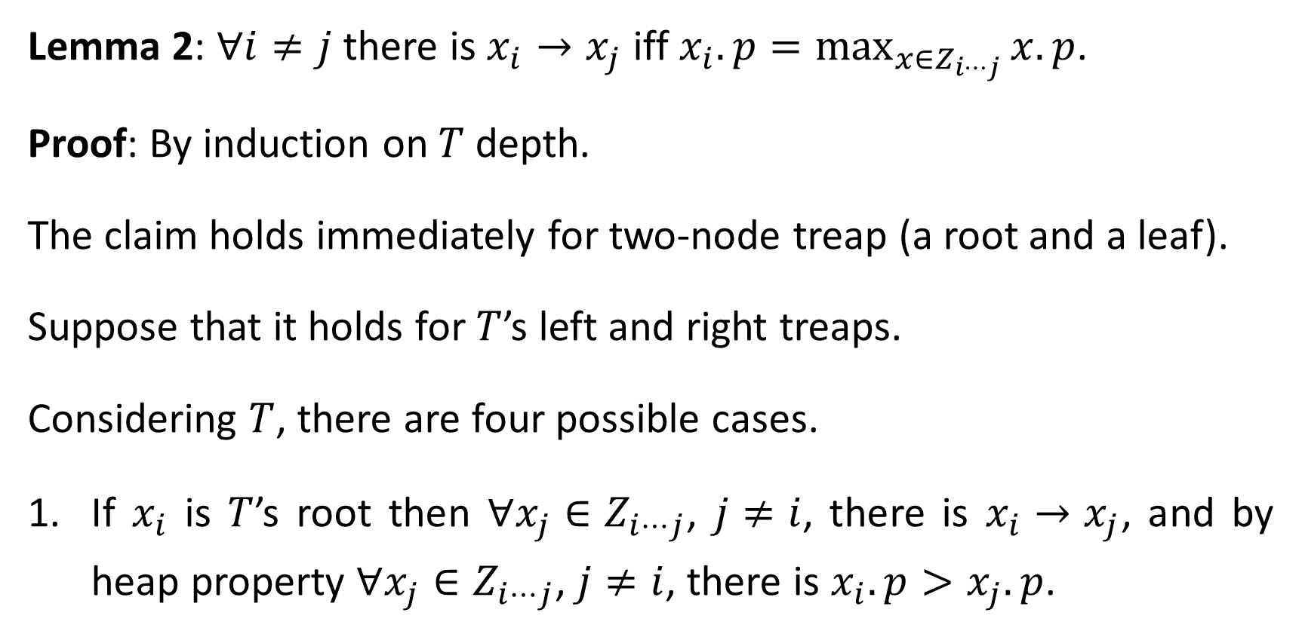
Lemma 2: $∀i≠j$ there is $x_{i}→x_{j}$ iff $x_{i}.p=\max_{{x∈Z}_{i⋯j}}{x.p}$.
Proof: By induction on $T$depth.
The claim holds immediately for two-node treap (a root and a leaf).
Suppose that it holds for $T$’s left and right treaps.
Considering $T$, there are four possible cases.
If $x_{i}$ is $T$’s root then $∀x_{j}∈Z_{i⋯j}$, $j≠i$, there is $x_{i}→x_{j}$, and by heap property $∀x_{j}∈Z_{i⋯j}$, $j≠i$, there is $x_{i}.p>x_{j}.p$.

Slide 19
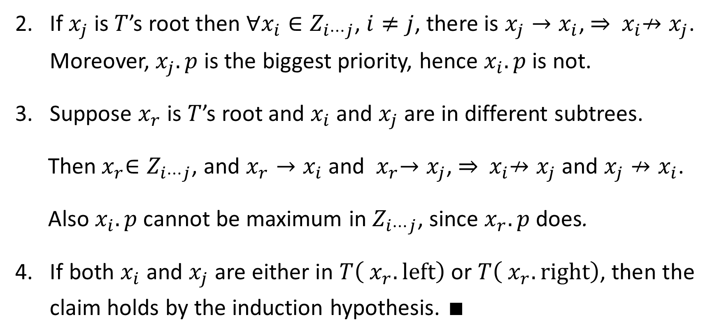
If $x_{j}$ is $T$’s root then $∀x_{i}∈Z_{i⋯j}$, $i≠j$, there is $x_{j}→x_{i}$, ⇒ ${ x}_{i}↛x_{j}$. Moreover, $x_{j}.p$ is the biggest priority, hence $x_{i}.p$ is not.
Suppose $x_{r}$ is $T$’s root and $x_{i}$ and $x_{j}$ are in different subtrees.
Then${{ x}_{r}∈Z}_{i⋯j}$, and $x_{r}→x_{i}$ and ${ x}_{r}→x_{j}$, ⇒ ${ x}_{i}↛x_{j}$ and $x_{j}↛x_{i}$.
Also $x_{i}.p$ cannot be maximum in $Z_{i⋯j}$, since $x_{r}.p$ does.
If both $x_{i}$ and $x_{j}$ are either in $T\left({ x}_{r}.\text{left}\right)$ or $T\left({ x}_{r}.\text{right}\right)$, then the claim holds by the induction hypothesis. ∎

Slide 20
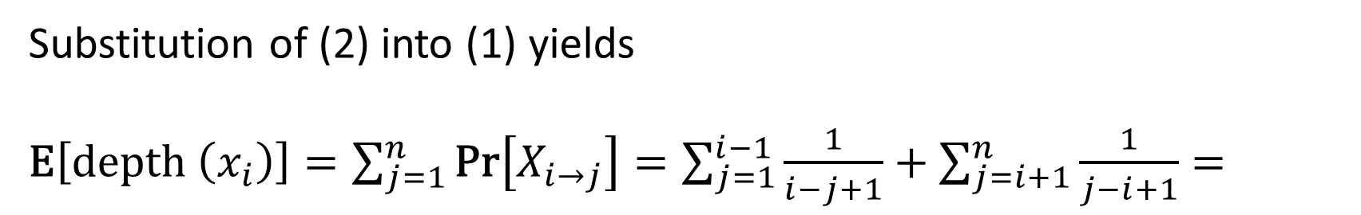
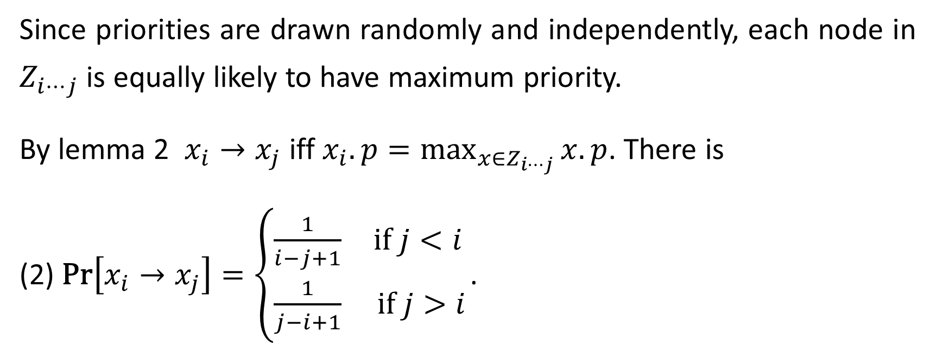


Since priorities are drawn randomly and independently, each node in $Z_{i⋯j}$ is equally likely to have maximum priority.
By lemma 2 $x_{i}→x_{j}$ iff $x_{i}.p=\max_{{x∈Z}_{i⋯j}}{x.p}$. There is
(2) $\text{Pr}\left[x_{i}→x_{j}\right]=\left\{\begin{matrix}\frac{1}{i−j+1} & \text{if} j<i \\ \frac{1}{j−i+1} & \text{if} j>i\end{matrix}\right.$.
Substitution of (2) into (1) yields
$\text{E}\left[\text{depth} \left(x_{i}\right)\right]=\sum_{j=1}^{n}{\text{Pr}\left[X_{i→j}\right]}=\sum_{j=1}^{i−1}{\frac{1}{i−j+1}}+\sum_{j=i+1}^{n}{\frac{1}{j−i+1}}=$
$$l=i−j+1$$
$$l=j−i+1$$

Slide 21

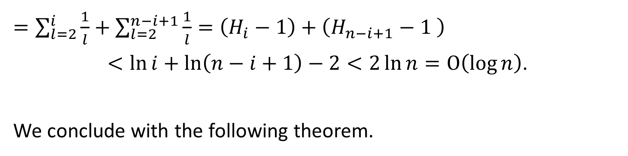
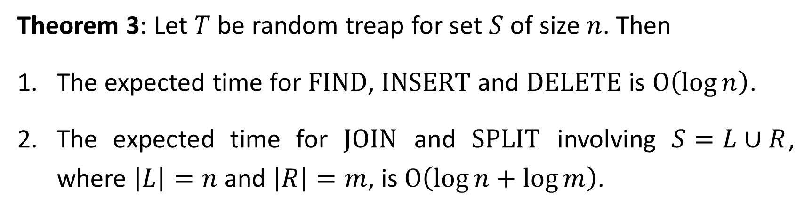
$=\sum_{l=2}^{i}{\frac{1}{l}}+\sum_{l=2}^{n−i+1}{\frac{1}{l}}=\left(H_{i}−1\right)+\left(H_{n−i+1}−1 \right)$
$$<\ln{i}+\ln\left(n−i+1\right)−2<2\ln{n}=O\left(\log{n}\right)\text{.}$$
We conclude with the following theorem.
$$H_{n}=\ln{n+Θ\left(1\right)}$$
Theorem 3: Let $T$ be random treap for set $S$ of size $n$. Then
The expected time for $\text{FIND}$, $\text{INSERT}$ and $\text{DELETE}$ is $O\left(\log{n}\right)$.
The expected time for $\text{JOIN}$ and $\text{SPLIT}$ involving $S=L∪R$, where $\left|L\right|=n$ and $\left|R\right|=m$, is $O\left(\log{n}+\log{m}\right)$.

Slide 22
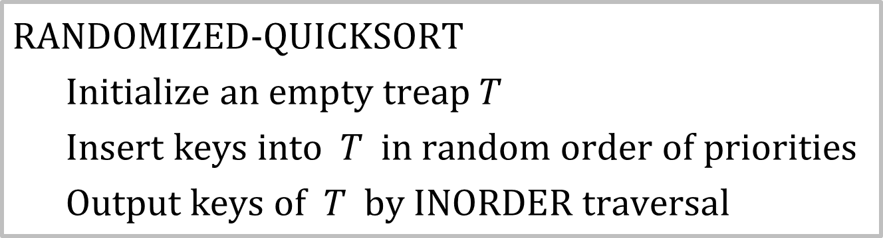
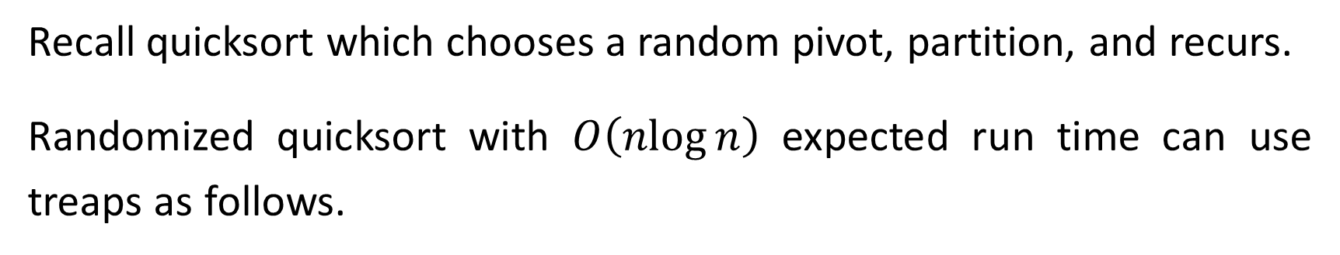
Randomized Quicksort
Recall quicksort which chooses a random pivot, partition, and recurs.
Randomized quicksort with $O\left(\operatorname{nlog}{n}\right)$ expected run time can use treaps as follows.
$\text{RANDOMIZED}\text{−}\text{QUICKSORT}$
$\text{Initialize} \text{an} \text{empty} \text{treap} T$
$\text{Insert} \text{keys} \text{into} T \text{in} \text{random} \text{order} \text{of} \text{priorities}$
$\text{Output} \text{keys} \text{of} T \text{by} \text{INORDER} \text{traversal}$
HW: Prove correctness and runtime of $\text{RANDOMIZED}\text{−}\text{QUICKSORT}$.

